Slide 1
Microlecture - Design Yoshi’s Fruit Adventure
CS 4730 – Computer Game Design
Mark Floryan

Slide 2
Super Mario Sunshine

Slide 3
Super Mario Sunshine
For the record: a lot of things I love about this game:
The island aesthetic / overall style
Mario’s movement / FLUDD are well done
A lot of the levels are really fun
Game is actually much harder than most Mario games
…but there are some levels that, in my opinion, are unforgivable.

Slide 4
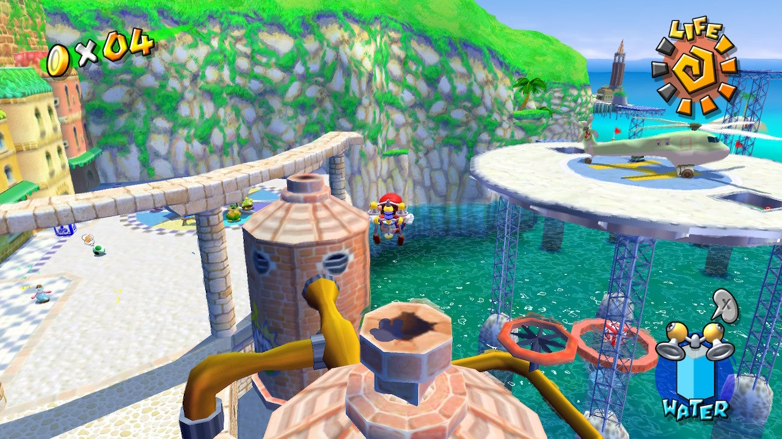
Yoshi’s Fruit Adventure

Slide 5
Yoshi’s Fruit Adventure
The intended route:
https://www.youtube.com/watch?v=zf_AdG01YVY

Slide 6
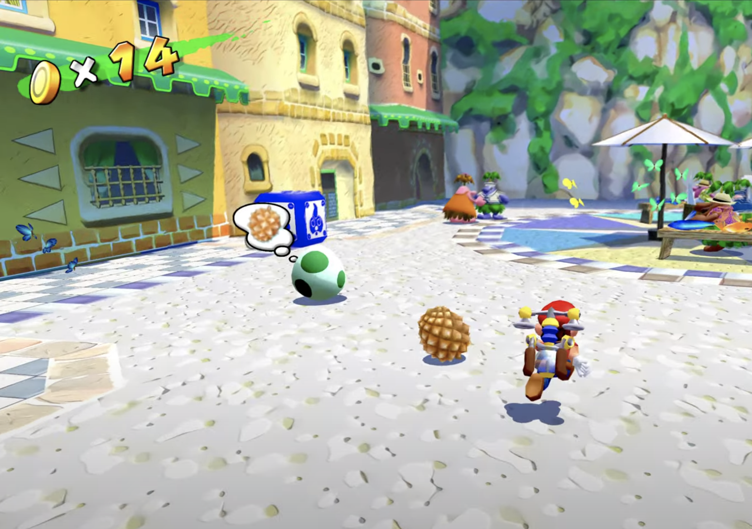
Problem 1
Yoshi’s Egg might not even be there!!!
Have to do a pre-requisite elsewhere in game to make to appear

Slide 7
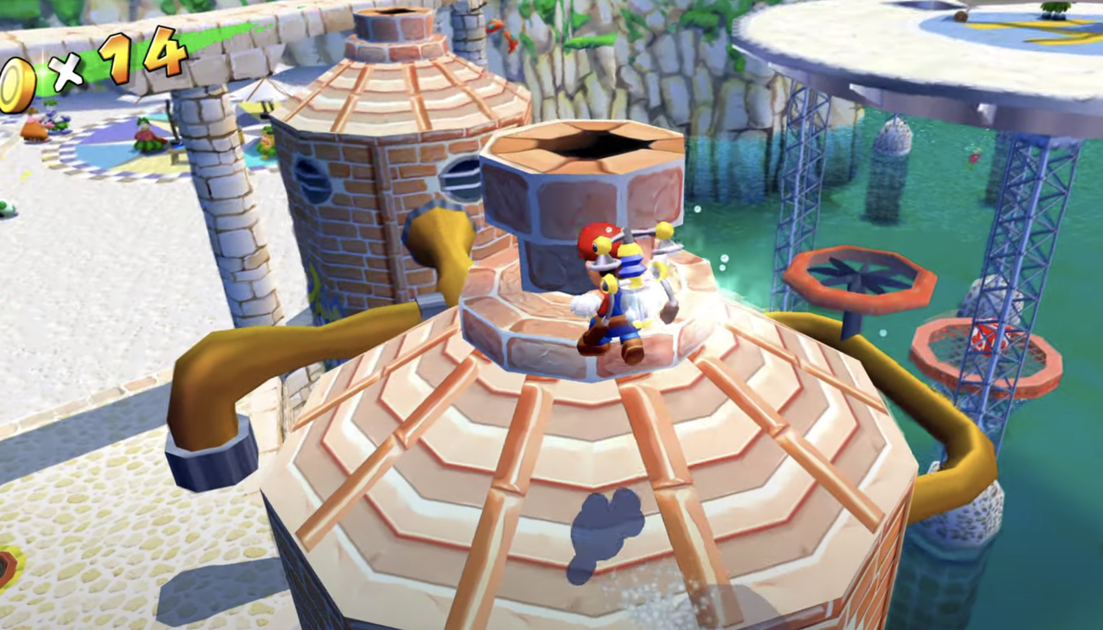
Problem 2
Fruit lottery machine does not visually clue you in that you can stomp the top

Slide 8
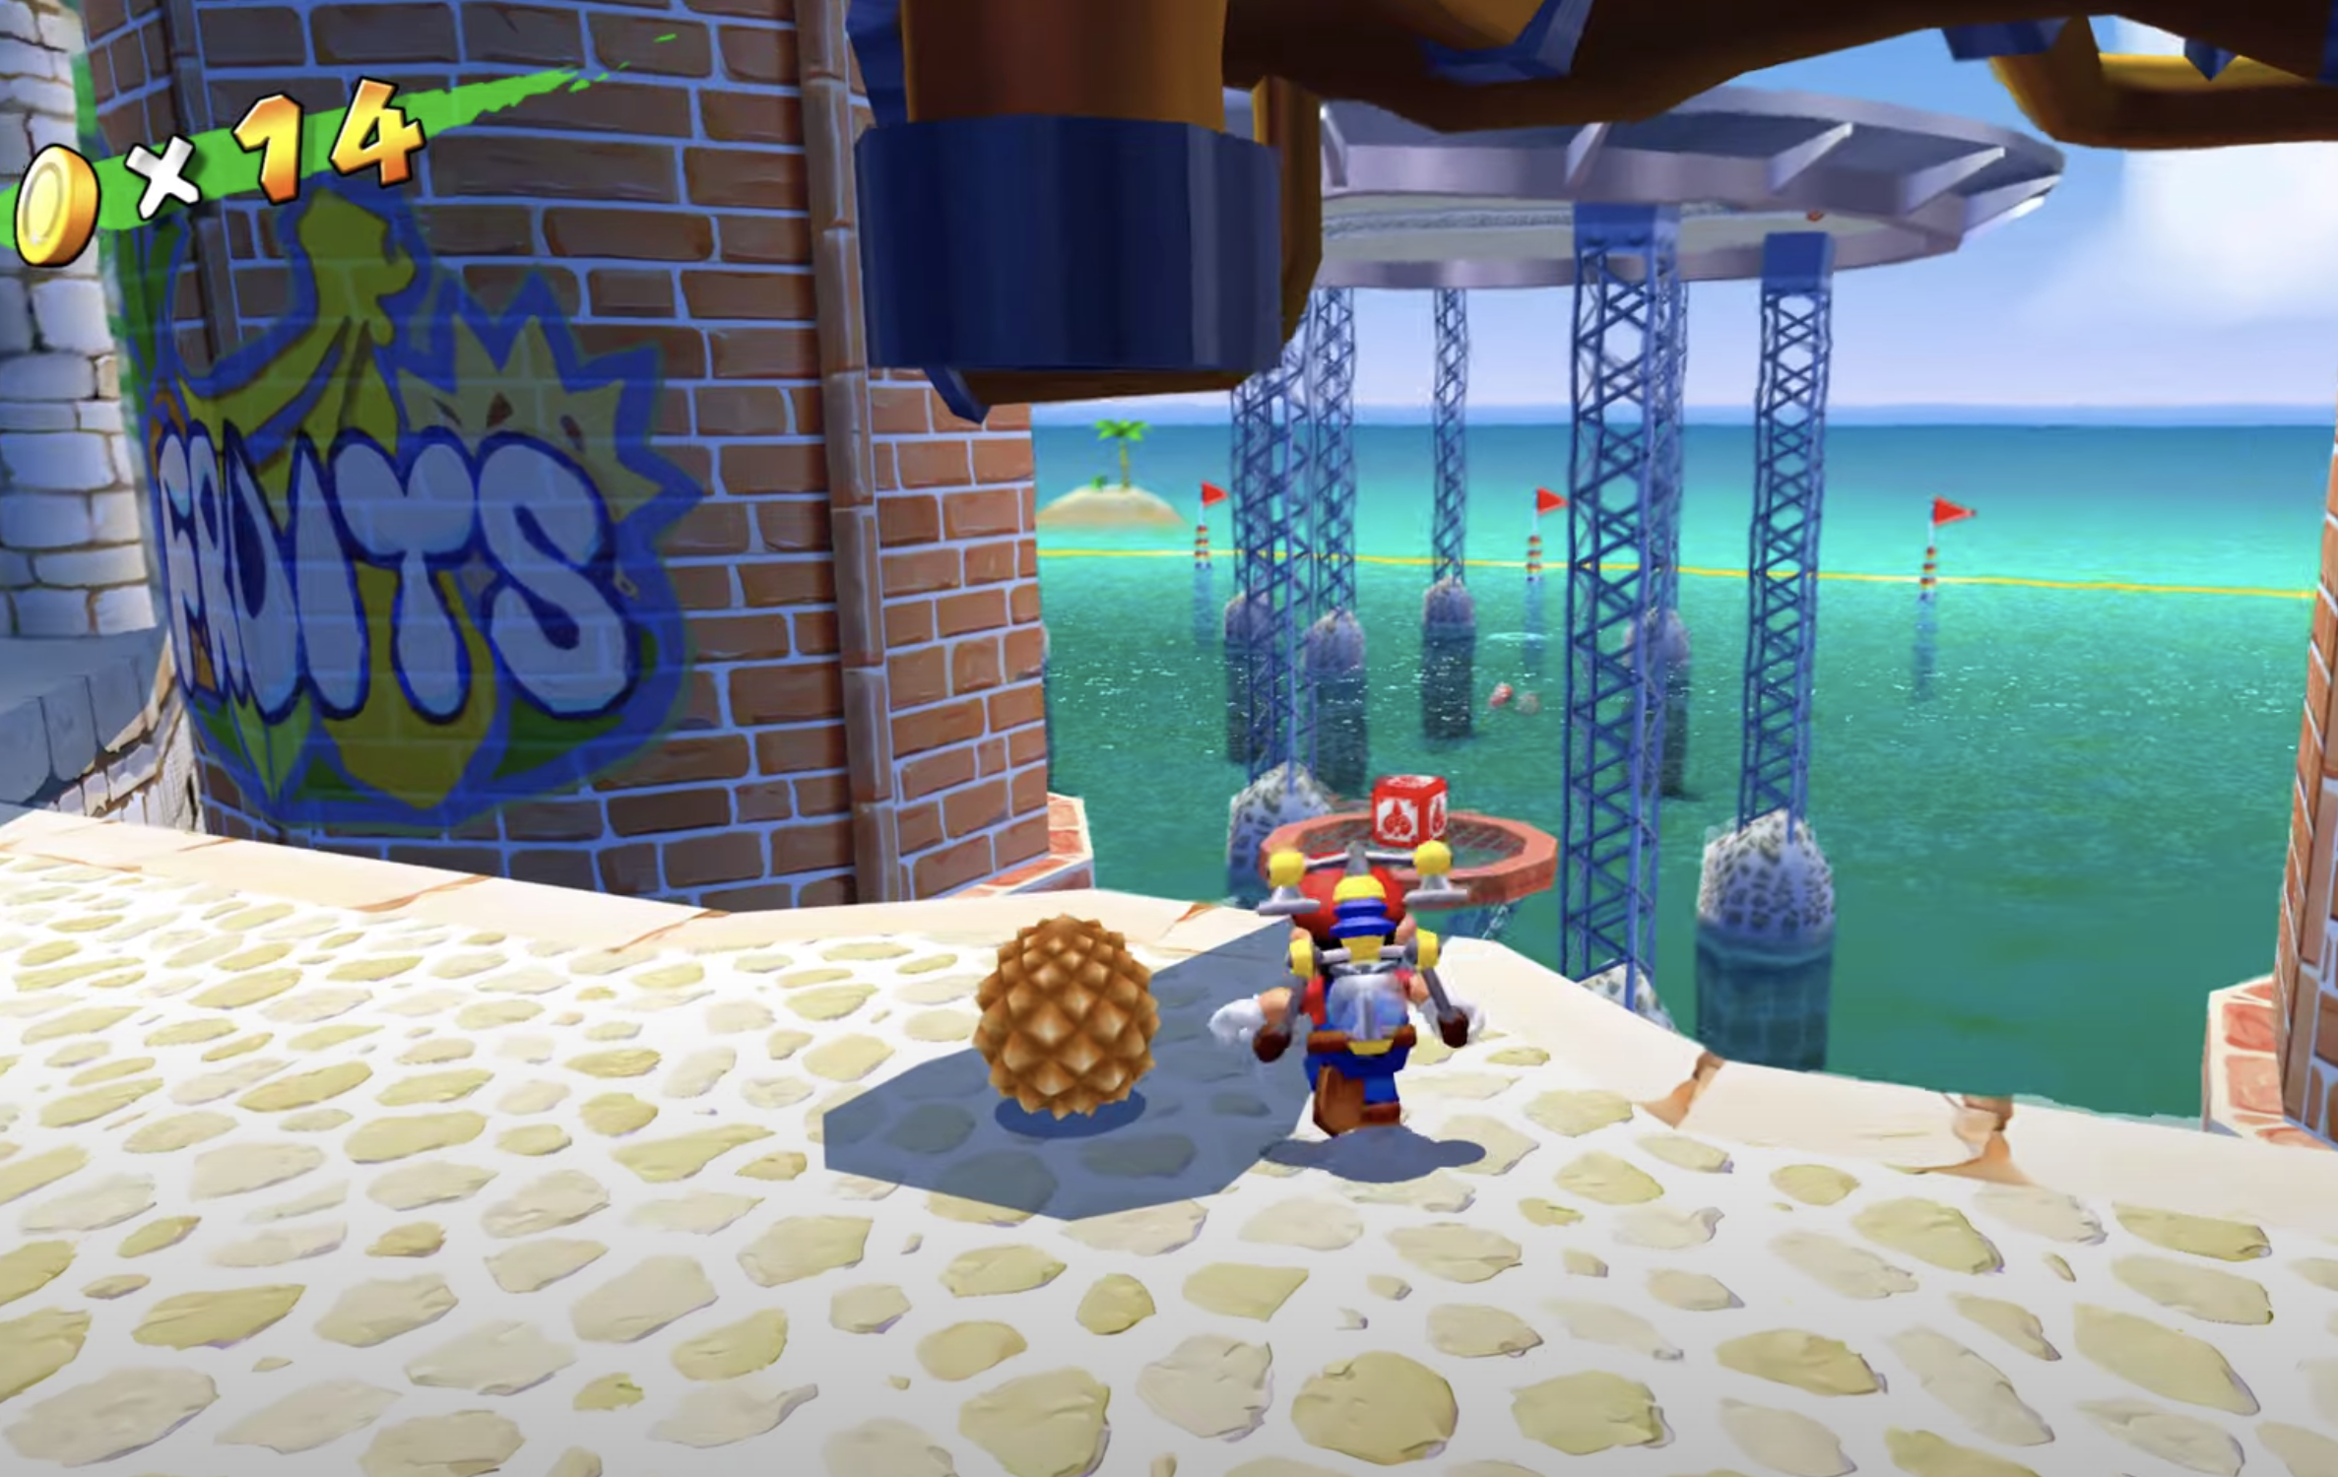
Problem 3
Fruit Lottery: Need to stomp until correct fruit comes out. Only 4 can be out at once. Ugh!

Slide 9
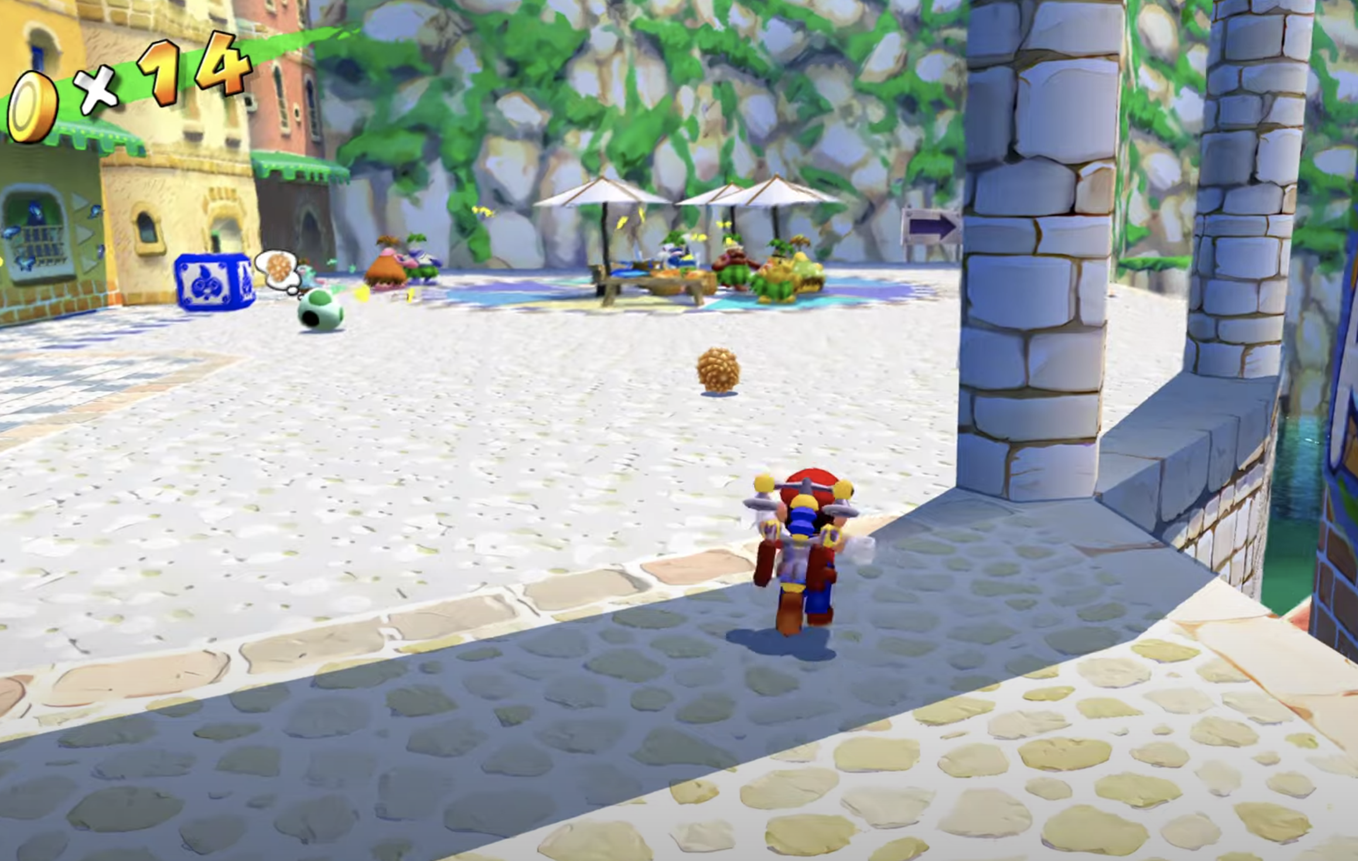
Problem 4
The Durian is the ONLY fruit you can’t carry, but have to ‘kick’ to Yoshi

Slide 10
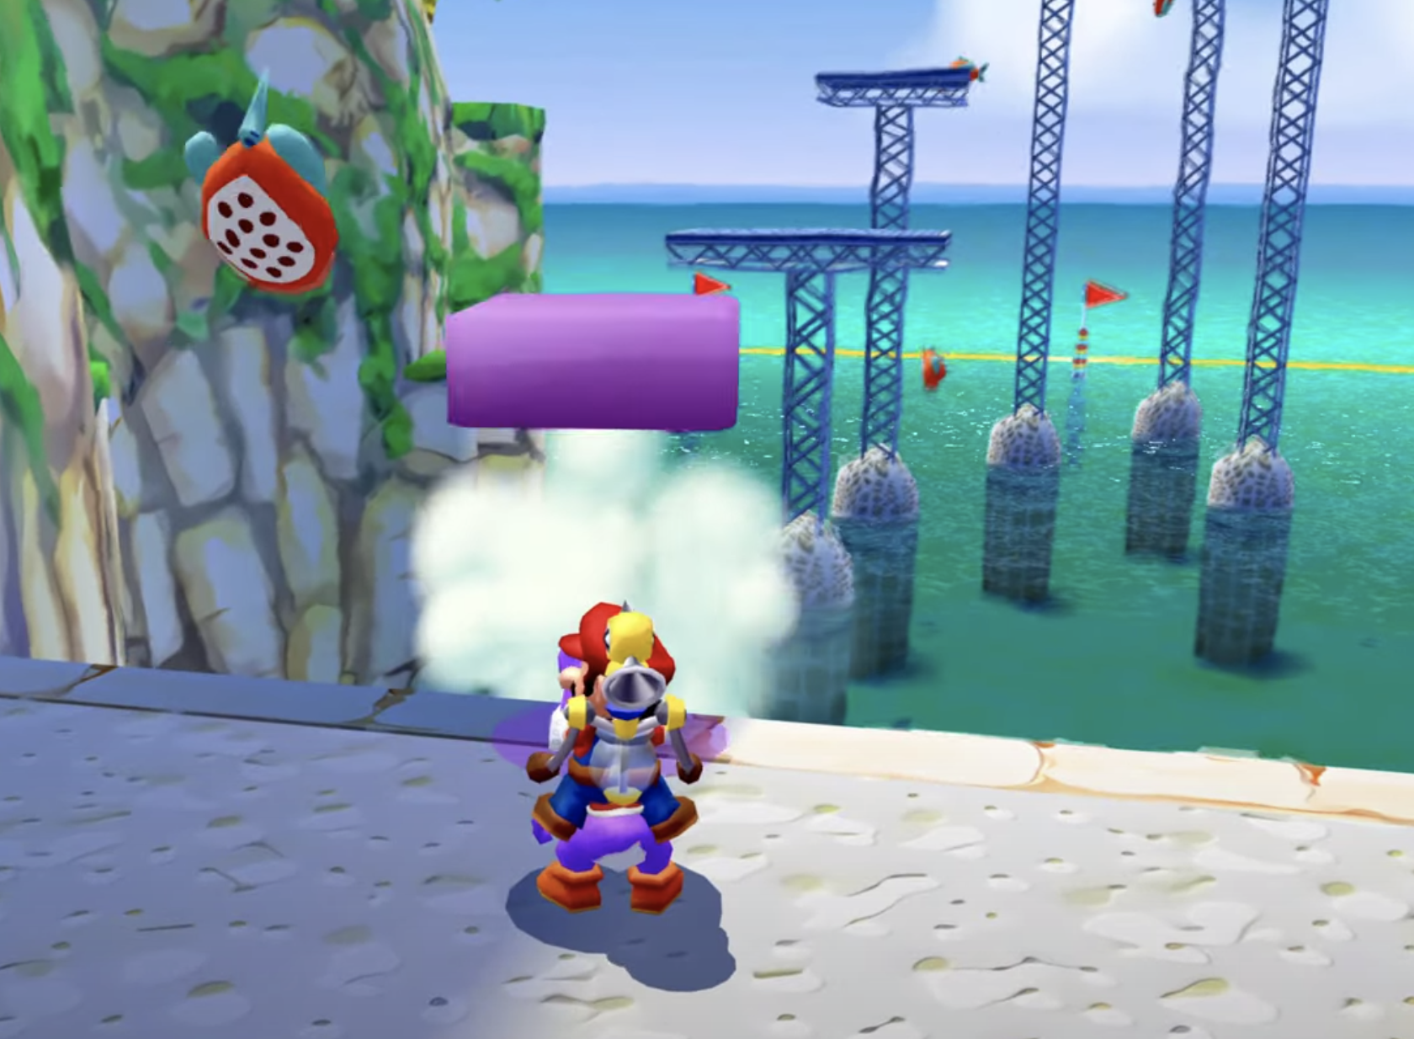
Problem 5
Yoshi spitting on fish turns them into platforms
Whaaaaaat!!!? How was anyone supposed to know this?

Slide 11
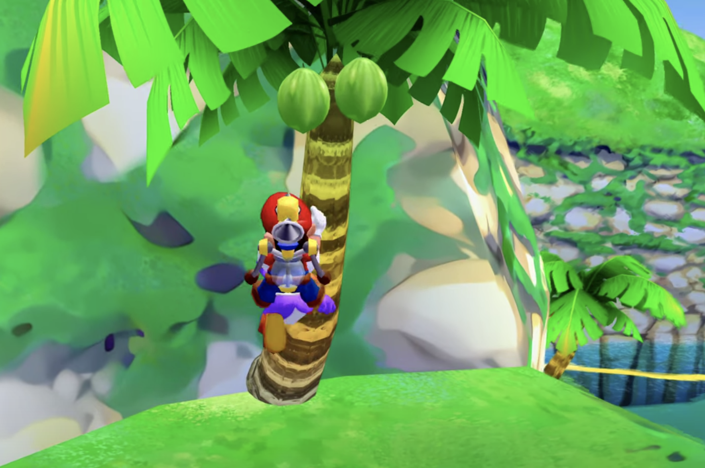
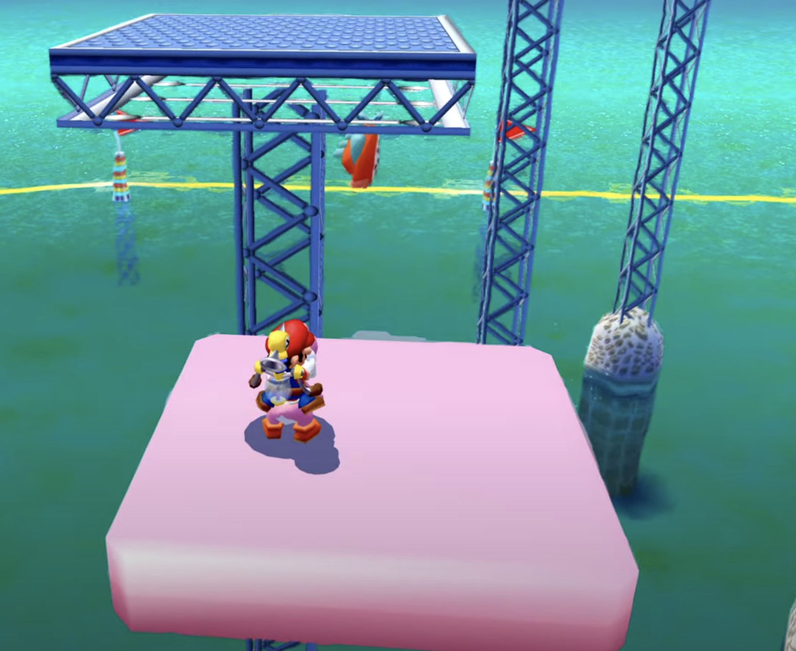
Problem 6
You have to eat a melon to make Yoshi pink which makes platforms go up? What!!!??

Slide 12
Problem 7
If you fail, you need to swim ALL the way back (Mario is SLOW at swimming) and restart at the FRUIT LOTTERY AGAIN!!

Slide 13
Potential Fixes
Make egg always there OR ensure hard pre-requisite
Make top of fruit machine visually distinct (can be subtle)
Fake the probabilities so Durian is guaranteed within 2 or 3 stomps (Games do this all the time btw)
Use a fruit that can be carried. Kicking the Durian is NOT a fun minigame
Somehow communicate the spitting on fish mechanic
Any thoughts on how? It is not a very natural mechanic
Completely remove the pit stop to eat the melon. Is a puzzle that makes zero sense.
Make Yoshi/Mario reset to level after Yoshi obtained if you fall

